Slide 1
Modul Aset Versi 3.3
Berdasarkan Permendagri No. 47 Tahun 2021
https://drive.google.com/file/d/1hCgPanVBZhhjygjEyg9gh0I7-ZdiJSxb/view?usp=sharing

Slide 2
Outline
1. A) Perolehan/Penerimaan BAST Hibah dan Lainnya
BOS
BLUD
Ketentuan Perundang-undangan
Putusan Pengadilan
Divestasi
Pembatalan Penghapusan
Perolehan/Penerimaan Lainnya
3. A) Penerimaan BMD Internal Pengguna Barang >Tambah KDTANS dan Menu Penerimaan BMD
4. A) Pengeluaran BMD Internal Pengguna Barang > Tambah KDTANS dan Menu Pengeluaran BMD Internal (NOT OK, KDTANS=226 vs 3.A 126)

Slide 3
Outline
5. A) Pemanfaatan > Form Pemanfaatan Sewa, KSP, BGS, BSG, KSP C) Pemanfaatan > Tambah KDTANS dan Menu Sub Menu ‘Pinjam Pakai’ dibawah ‘Sewa’
6. A) Reklasifikasi > Tambah KDTANS dan Sub Reklasifikasi ‘Persediaan ke Aset Tetap’
7. A) Koreksi > Tambah KDTANS dan Sub Menu ‘Koreksi Pencatatan Ganda’ B) Koreksi > Tambah KDTANS dan Sub Menu ‘Koreksi Spesifikasi C) Koreksi > Tambah KDTANS dan Sub Menu ‘Koreksi Lainnya’
8. A) Penghapusan > Tambah Field Option DI Form Penghapusan
Rencana Pengembangan Lanjutan

Slide 4
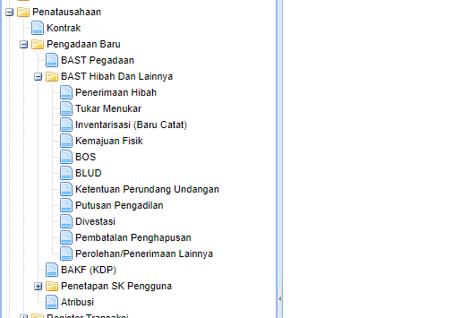
Perolehan/Penerimaan BAST Hibah dan Lainnya
Penambahan Menu untuk BAST:
1. Ketentuan Peraturan -Perundang-
undangan
2. Putusan Pengadilan yang Telah
Mempunyai Kekuatan Hukum Tetap
3. Divestasi
4. Pembatalan Penghapusan (bisa look up
penghapusan yang belum tervalidasi)
5. Perolehan/Penerimaan Lainnya

Slide 5
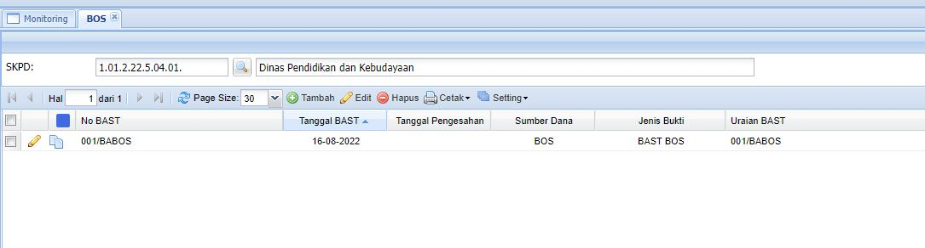
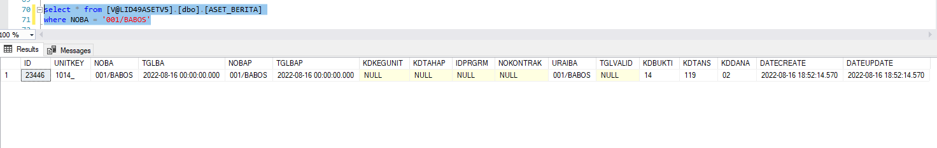
BOS
Tambah Baris Di SS01APPMENU → Script Update Modul Aset PP47_2021.sql
KDMENU = 04.02.03.05.
Olist1 = Usadi.Valid49.BO.BeritaBosControl, Usadi.Valid49.Aset.MAT
Create Class BeritaBos.cs → BeritaBosControl
SetPageKey → KDTANS = 119, KDBUKTI = 14
Screenshot Aplikasi
Screenshot Database

Slide 6
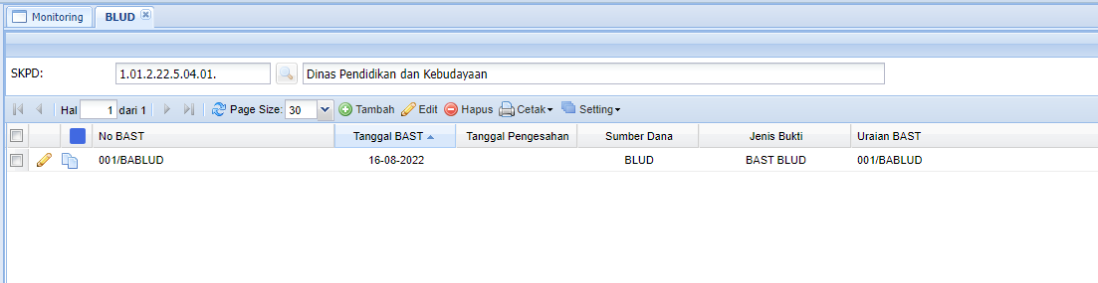
BLUD
Tambah Baris Di SS01APPMENU → Script Update Modul Aset PP47_2021.sql
KDMENU = 04.02.03.06.
Olist1 = Usadi.Valid49.BO.BeritaBludControl, Usadi.Valid49.Aset.MAT
Create Class BeritaBlud.cs → BeritaBludControl
SetPageKey → KDTANS = 120, KDBUKTI = 15
Screenshot Aplikasi
Screenshot Database

Slide 7
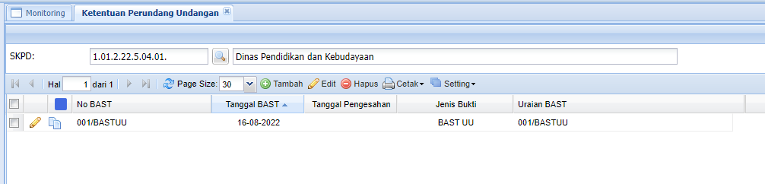
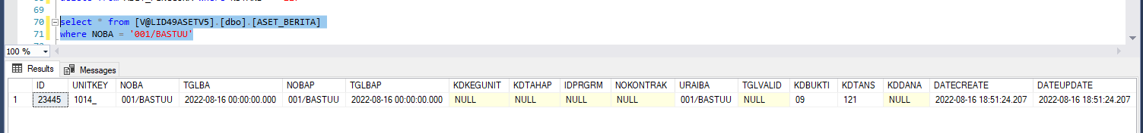
Ketentuan Perundang Undangan
Tambah Baris Di SS01APPMENU → Script Update Modul Aset PP47_2021.sql
KDMENU = 04.02.03.07.
Olist1 = Usadi.Valid49.BO.BeritaUUControl, Usadi.Valid49.Aset.MAT
Create Class BeritaUU.cs → BeritaUUControl
SetPageKey → KDTANS = 121, KDBUKTI = 09
Screenshot Aplikasi
Screenshot Database

Slide 8
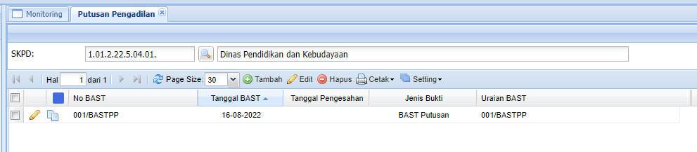
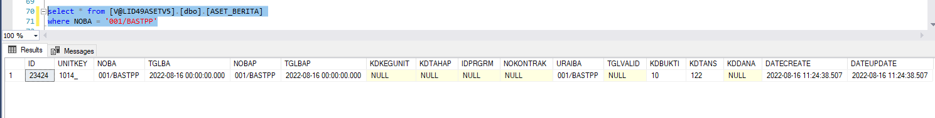
Putusan Pengadilan
Tambah Baris Di SS01APPMENU → Script Update Modul Aset PP47_2021.sql
KDMENU = 04.02.03.08.
Olist1 = Usadi.Valid49.BO.BeritaPutusanControl, Usadi.Valid49.Aset.MAT
Create Class BeritaPutusan.cs → BeritaPutusanControl
SetPageKey → KDTANS = 122, KDBUKTI = 10
Screenshot Aplikasi
Screenshot Database

Slide 9
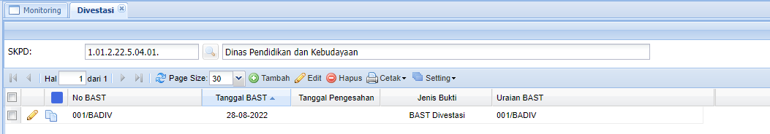
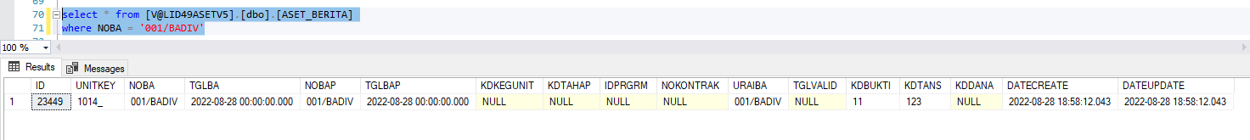
Divestasi
Tambah Baris Di SS01APPMENU → Script Update Modul Aset PP47_2021.sql
KDMENU = 04.02.03.09.
Olist1 = Usadi.Valid49.BO.BeritaDivestasiControl, Usadi.Valid49.Aset.MAT
Create Class BeritaDivestasi.cs → BeritaDivestasiControl
SetPageKey → KDTANS = 123, KDBUKTI = 11
Screenshot Aplikasi
Screenshot Database

Slide 10
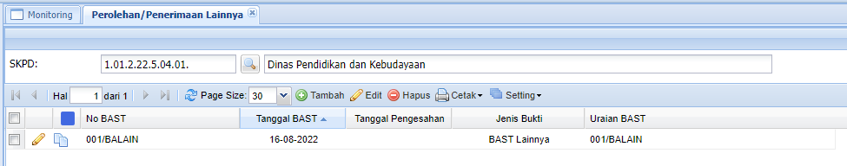
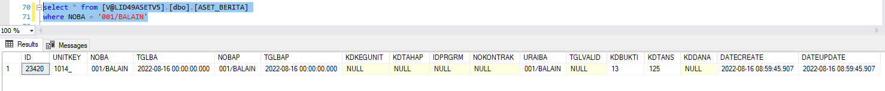
Perolehan/Penerimaan Lainnya
Tambah Baris Di SS01APPMENU → Script Update Modul Aset PP47_2021.sql
KDMENU = 04.02.03.11.
Olist1 = Usadi.Valid49.BO.BeritaLainnyaControl, Usadi.Valid49.Aset.MAT
Create Class BeritaLainnya.cs → BeritaLainnyaControl
SetPageKey → KDTANS = 125, KDBUKTI = 13
Screenshot Aplikasi
Screenshot Database

Slide 11
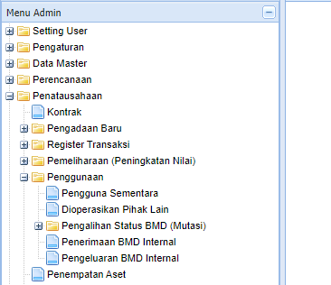
Penerimaan BMD Internal Pengguna Barang

Slide 12
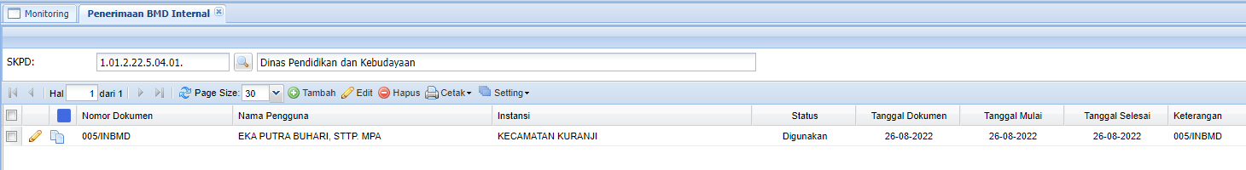
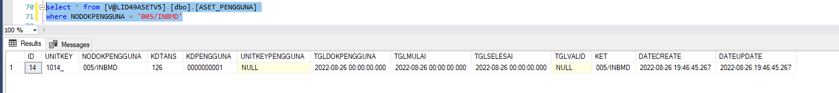
Penerimaan BMD Internal
Tambah Baris Di SS01APPMENU → Script Update Modul Aset PP47_2021.sql
KDMENU = 04.05.04.
Olist1 = Usadi.Valid49.BO.PenerimaanBmdInternalControl, Usadi.Valid49.Aset.MAT
Create Class Pengguna.cs → PenerimaanBmdInternalControl
SetPageKey → KDTANS = 126
Screenshot Aplikasi
Screenshot Database

Slide 13
Pengeluaran BMD Internal Pengguna Barang

Slide 14
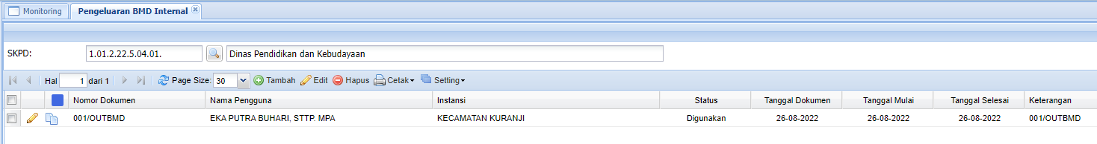
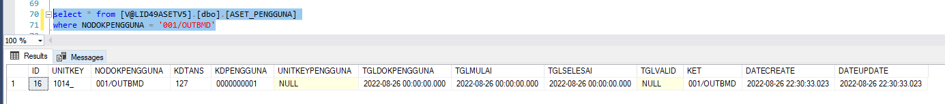
Pengeluaran BMD Internal
Tambah Baris Di SS01APPMENU → Script Update Modul Aset PP47_2021.sql
KDMENU = 04.05.05.
Olist1 = Usadi.Valid49.BO.PengeluaranBmdInternalControl, Usadi.Valid49.Aset.MAT
Create Class Pengguna.cs → PengeluaranBmdInternalControl
SetPageKey → KDTANS = 127 → 226
Screenshot Aplikasi
Screenshot Database

Slide 15
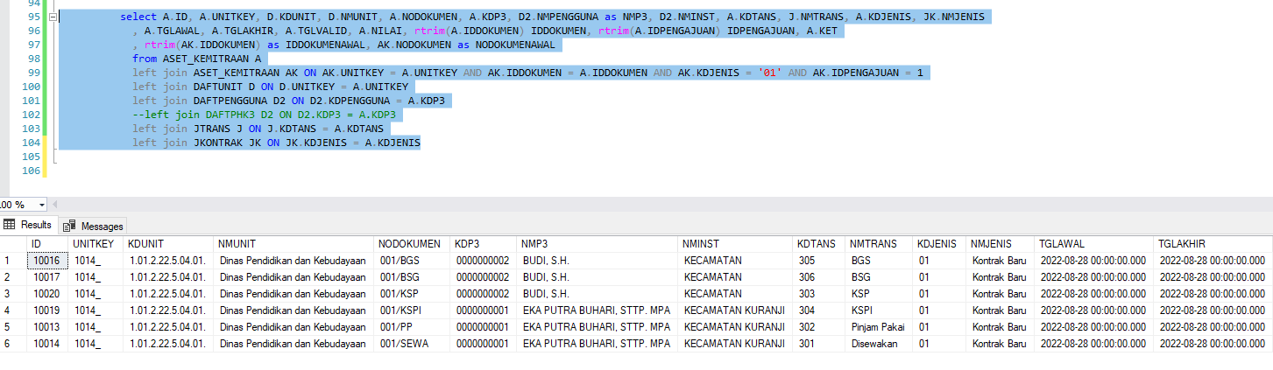
Pemanfaatan > Form Pemanfaatan Sewa, KSP, BGS, BSG, KSP
Usadi.Valid49.BO.Daftphk3LookupControl, Usadi.Valid49.Aset.MAT
Usadi.Valid49.BO.KemitraanControl, Usadi.Valid49.Aset.MAT
Usadi.Valid49.BO.DaftpenggunaLookupControl, Usadi.Valid49.Aset.MAT
Screenshot Database

Slide 16
Sewa
KSP
BGS
BSG
KSPI

Slide 17
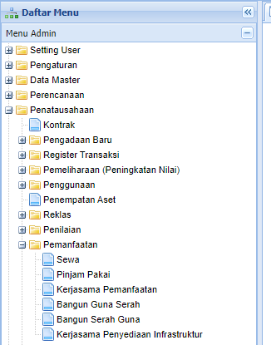
Pemanfaatan > Tambah KDTANS dan Menu Sub Menu ‘Pinjam Pakai’ dibawah ‘Sewa’

Slide 18
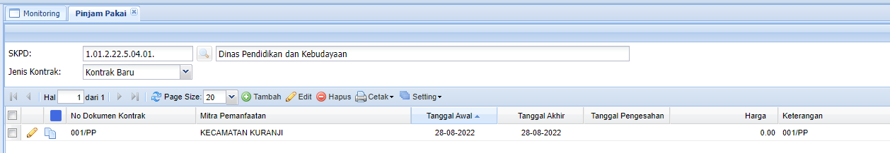
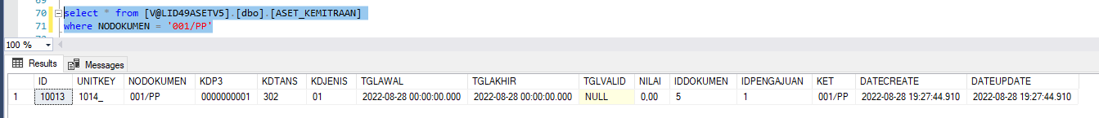
Pinjam Pakai
Tambah Baris Di SS01APPMENU → Script Update Modul Aset PP47_2021.sql
KDMENU = 04.10`.02.
Olist1 = Usadi.Valid49.BO.PinjamPakaiControl, Usadi.Valid49.Aset.MAT
Create Class Kemitraan.cs → PinjamPakaiControl
SetPageKey → KDTANS = 220
Screenshot Aplikasi
Screenshot Database

Slide 19
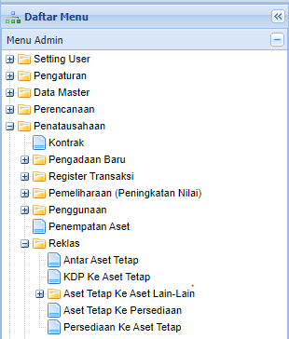
Reklasifikasi > Tambah KDTANS dan Sub Reklasifikasi ‘Persediaan ke Aset Tetap’

Slide 20
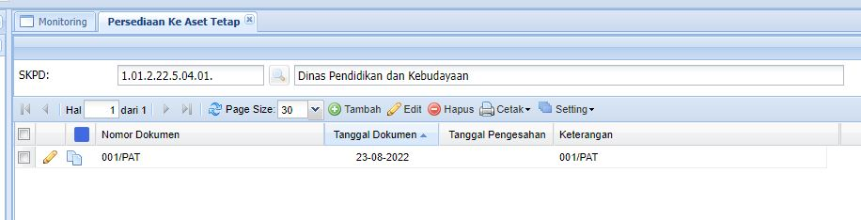
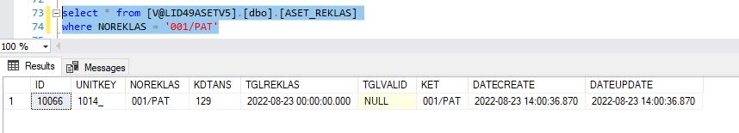
Persediaan Ke Aset Tetap
Tambah Baris Di SS01APPMENU → Script Update Modul Aset PP47_2021.sql
KDMENU = 04.07.05.
Olist1 = Usadi.Valid49.BO.ReklasPersediaanToTetapControl, Usadi.Valid49.Aset.MAT
KDTANS Kebalikan dari AsetTetap ke Persediaan
Create Class Reklas.cs → ReklasPersediaanToTetapControl (209)
SetPageKey → KDTANS = 129 → 109 → 1XX
Screenshot Aplikasi
Screenshot Database

Slide 21
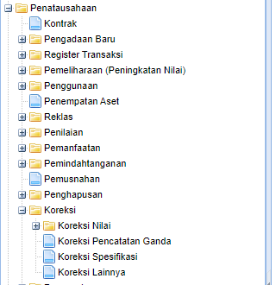
Koreksi > Tambah KDTANS dan Sub Menu ‘Koreksi Pencatatan Ganda’

Slide 22
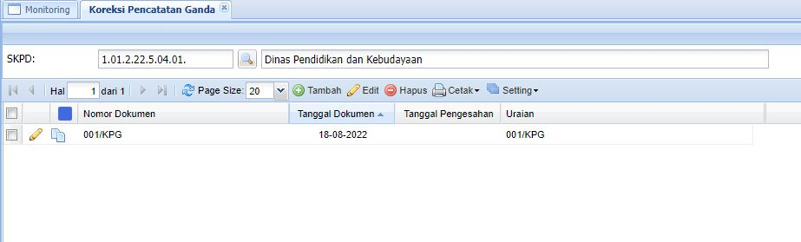
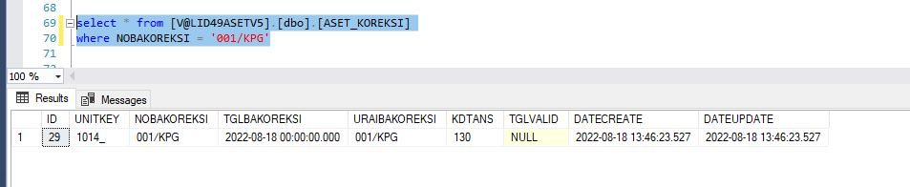
Koreksi Pencatatan Ganda
Tambah Baris Di SS01APPMENU → Script Update Modul Aset PP47_2021.sql
KDMENU = 04.15.02.
Olist1 = Usadi.Valid49.BO.KoreksiGandaControl, Usadi.Valid49.Aset.MAT
Create Class Koreksi.cs → KoreksiGandaControl
SetPageKey → KDTANS = 130
Screenshot Aplikasi
Screenshot Database

Slide 23
Koreksi > Tambah KDTANS dan Sub Menu ‘Koreksi Spesifikasi

Slide 24
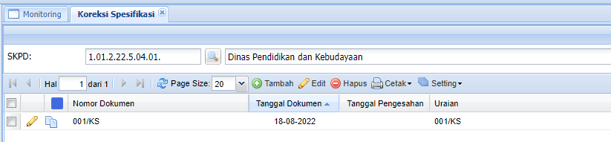
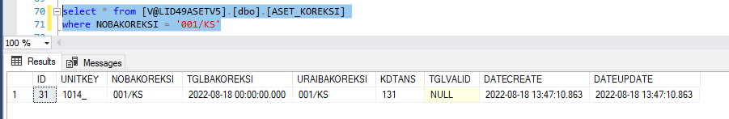
Koreksi Spesifikasi
Tambah Baris Di SS01APPMENU → Script Update Modul Aset PP47_2021.sql
KDMENU = 04.15.03.
Olist1 = Usadi.Valid49.BO.KoreksiSpesifikasiControl, Usadi.Valid49.Aset.MAT
Create Class Koreksi.cs → KoreksiSpesifikasiControl
SetPageKey → KDTANS = 131
Screenshot Aplikasi
Screenshot Database

Slide 25
Koreksi > Tambah KDTANS dan Sub Menu ‘Koreksi Lainnya’

Slide 26
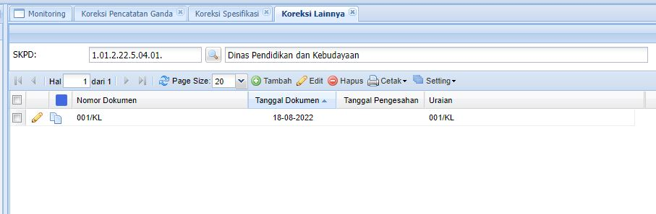
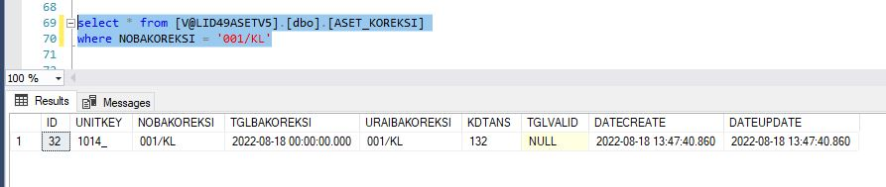
Koreksi Lainnya
Tambah Baris Di SS01APPMENU → Script Update Modul Aset PP47_2021.sql
KDMENU = 04.15.04.
Olist1 = Usadi.Valid49.BO.KoreksiLainnyaControl, Usadi.Valid49.Aset.MAT
Create Class Koreksi.cs → KoreksiLainnyaControl
SetPageKey → KDTANS = 132
Screenshot Aplikasi
Screenshot Database

Slide 27
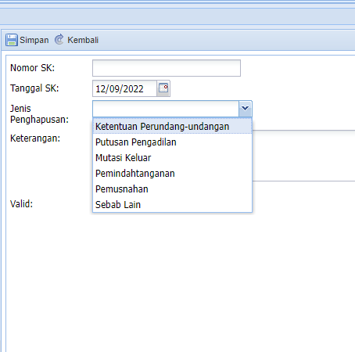
Penghapusan (Form Penghapusan)

Slide 28
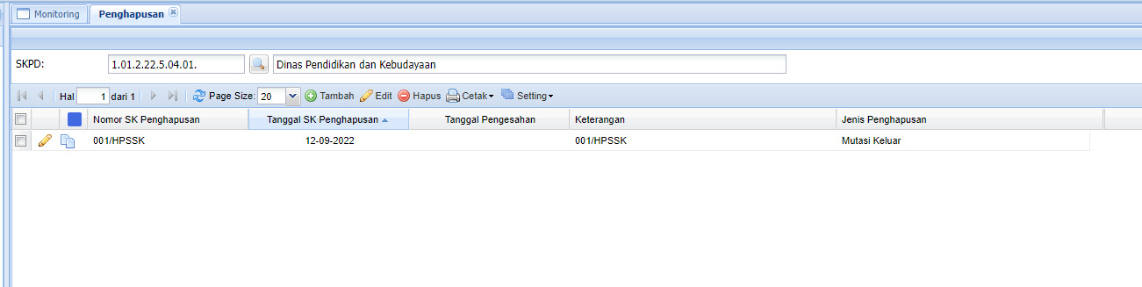
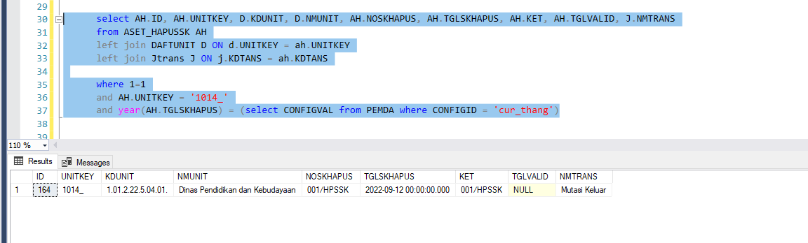
Penghapusan
Tambah KDTANS Untuk Field Option→ Script Update Modul Aset PP47_2021.sql
KDMENU = 04.13.
Olist1 = Usadi.Valid49.BO.HapusskControl, Usadi.Valid49.Aset.MAT
KDTANS = 2XX
Class Hapussk.cs → HapusskControl

Slide 29
Rencana Pengembangan Report Modul Aset sesuai Permendagri No 47/2021
Struktur Tim Modul Aset
Technical Leader: Hendi Wibowo
Product Owner: Shaiful
Developer: Julian, Wuri, Risma
Scrum Board - Scrum Board - Agile Board - Jira (atlassian.net)
PI Planning → Oktober-Desember 2022, untuk pengembangan report
10 minggu ~ 10 sprints
Demo setiap 2 minggu sekali
Development/Demo Server → Server Demo Usadi, Zacki

Slide 30
Action Item
30/09. Shaiful, dibantu Risma dan Wuri, menambahkan backlog Modul Aset di Scrum Board - Scrum Board - Agile Board - Jira (atlassian.net), dibagi ke dalam Sprint 5 s.d Sprint 15 (paling banyak, boleh lebih sedikit)
Fitur UI klo ada yg kurang (Permen 47/2021)
Report2 Permen 47/2021
Bug di UI/report
Performance
30/09. Menyiapkan installer/update Modul Aset 3.3. (Hendi/Julian)
Aplikasi (ZipExtractor, *.exe), wizard untuk update files
Scripts (SMARTSYS, VALID49XXX)
30/09. Shaiful request update Modul Aset di Server Demo ke Zacki
29/09. Shaiful memanage WAG
30/09. Kick of Pengembangan Report Modul Aset → Sprint planning (Semua Tim)
Scoping: Analisis&Perancangan: mirip dgn report yg mana aja, SP baru atau yg sdh ada

Slide 31
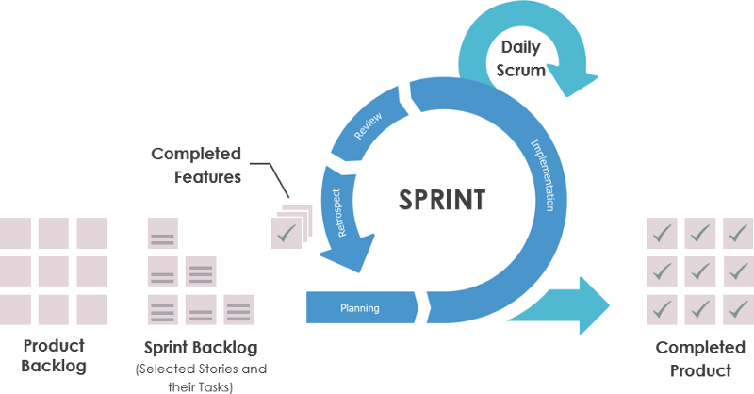
Scale Agile Framework (SAFe)

Slide 32
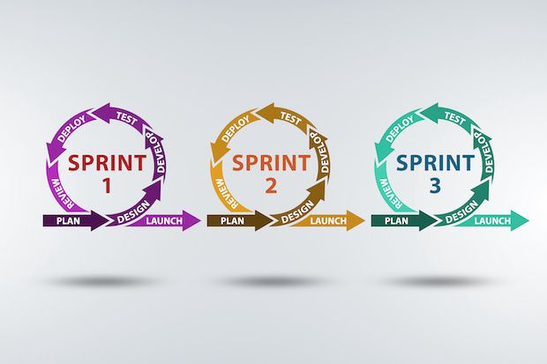
Scale Agile Framework (SAFe) (2)

Slide 33
Team Responsibility
Product Owner
Own Backlog & Priority
Manage Epic & Story Expectation
Scrum Master
Own the Culture & Process
Protect the team, ensure the team could focus achieve their sprint commitments
Technical Lead
Authorized for technical decisions within team
Up skill team members
Scrum Master of Scrum Master, Release Manager
Internal Audit Manager
Safety Manager
Solution Architect
Team
Work with PSM, Architect & Tech Leads to define Product Strategy
Broadcast Roadmap
Influence & coach the team on best agile practice & spirit
Serving the team for misc. task
Self manage
Own the Quality of Product
Align technical decision with Architect
Authorized to drive product development
Own inter-team culture & process
Standardize software dev & test process
Serving inter-team for misc. task
Own official process document & approval
Inter-team coordination
Monitor & Audit dev & test process
Own Safety & Security Practice
Monitor & Audit inter-team safety measurement & security concern
Own Solution Concept & Design
Own EDMI Interface Standardization
Technology Evaluation, Research & Decision
Own the Commitment
Own the definition of DONE
Cross Functional
Authorized for product decision making
Facilitating team events
Influence & coach scrum masters
Facilitating inter-team events
Align process with scrum masters
Authorized for Solution Strategic Decision
Help & cover each other
Senior to bring up Juniors
Ice Breaking

Slide 34
The Culture
Everyone to be self monitoring
Time track in Jira is NOT meant for management to monitor employees!
Time track (Tempo) is
A tool for developers to monitor their target workload & time spent.
For Product Owner & HOD to track estimated budget vs actual, to justify/review the investment
For HOD to report to Osaki on actual effort spending on each pre planned Epic/Feature.
Everyone to set target workload. (1) Set target (2) Log time (3) monitor & compare with target workload
e.g. Team member 80% development + testing, 10% ad-hoc dev/task, 10% support
e.g. scrum master 40% scrum, 50% create/review test case, 10% admin task
E.g. product owner 50% backlog grooming, 20% product manage, 20% support, 10% admin task
Tech Lead
Regular discussion with other Tech-Lead & Architect to align technology, techniques & best practice. Learning from each other & influence to team
Initiatively request for potential change of tech lead every 2 PI (6 months)
Product Owner
It is NOT a team lead, learn how to let team decide the commitment
Conduct Fortnightly/Monthly roadmap & updates presentation to stakeholders, obtain feedbacks, potential new features / ideas, evaluate & raise to backlog (NDP/DPA)
PI Preparation
Product Owner to prepare backlogs for the next PI (or next 2 PI) with proper expectation & delivery including high level acceptance criteria. Product Owner should try to break down as detail as possible.
Scrum Master to assist Product Owner for story detail breakdown, scoping & estimation (in prepare for the next PI) by calling weekly / fortnightly meeting with PO, and involve relevant team members if no all.
If possible, PO & SM to get things prepared including all the purchase, equipment arrangement before next PI.
PI Planning
A full day events (extended to 2 days if needed). For Product Owner & Team to discuss & understand whole 6 sprints Epic, Stories, task.
Team commit the whole 6 sprints (3 months) stories & task
Sprint Events:
Sprint/Iteration planning (review & shift the sprint commitment)
Sprint/Iteration review (The team, may include Owner, reviews everything that they did in the sprint, including the stories and goals they did not achieve)
Sprint demo (may conduct every sprint or every 2 sprint to PO & Stakeholder depending on the situation)
Sprint retrospective (may conduct every sprint or every 2 sprint to discuss good/bad and how to improved)
Scrum Master
Monitor, encourage the practice & culture above
Host regular scrum of scrum meeting to keep each other updated

Slide 35
Product Owner Expectation
Take overall ownership of software and its strategy
Learn the market & customers needs, convey the vision and drive changes to product & behaviour
Translate product strategies to tasks for development
Manage backlog, priorities & timeline
Manage & broadcast product roadmap
Stakeholder management. Say NO to unreasonable request or request that are not aligned with product strategy

Slide 36
Software Delivery Manager Expectation
Work with team to define detail software and solution acceptance criteria
Receive released product from development team and automate software and solution acceptance and regression testing
Release software with appropriate user guides/manual
Lead a team of cross functional software/system analyst taking ownership for outsource software projects.
Working with stakeholders to define requirement, expected result & acceptance criteria
Automate acceptance testing, regression testing and release the outsource product.

Slide 37

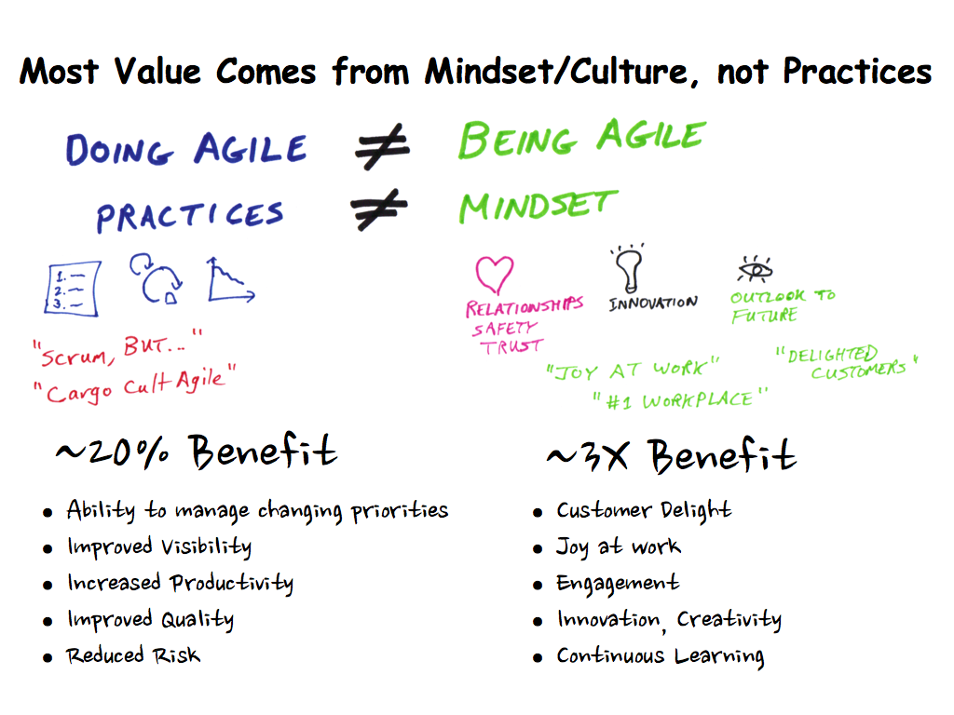
New Culture & Mindset

Slide 38
New Mindset for Developers
It is about self-organize & empowerment. Developer pick their task instead of waiting for manager to assign to them. Tasks were already in prioritize order, all task that were pickup are top priority task!
It is about accountable & job satisfaction, each developer are to co-own the product/project and will be accountable for the successful or failure of product.
It is about transparency & confident, knowing how important decisions was made by top management rather than just blindly following the instruction.
It is about acknowledge other’s contribution, not everyone could do every task or likes to do any task, there must be someone covered jobs that you don’t want to do.
All these will lead to a greater teamwork with more motivation, collaboration and recognition.
To ensure team spirit and everyone practice the same culture, Team Charter are normally being agreed among the team member at the very beginning. Violator of the team charter could lead to small punishment such as treat the entire team a lunch or could lead to serious punishment such as exile to other realms.

Slide 39
New Mindset for Leaders
It is about getting a more cross functional team rather than getting many heroes. No one in the team is indispensable, losing one key member the entire team could still continue functioning.
It is about getting a more highly collaborated & trustworthy team. In agile world, there will be no concept of solely responsible project/product manager, instead, the whole team are empowered & accountable, people from cross teams are communicate directly to each other without middleman, it is the whole team's responsible to make the project successful. Failing of project or product, the whole team (includes management) will has to be blamed.
It is about failing a project earlier rather than later. With focusing on highest value tasks and more frequent release cycle, critical problem or issues are often being discovered earlier, executive could then make business decision to drop the project earlier or to shift priority so resources could be better spend on other project.
It is about transparency, always knowing what are the teams doing and what are they supposed to do.

